Slide 1
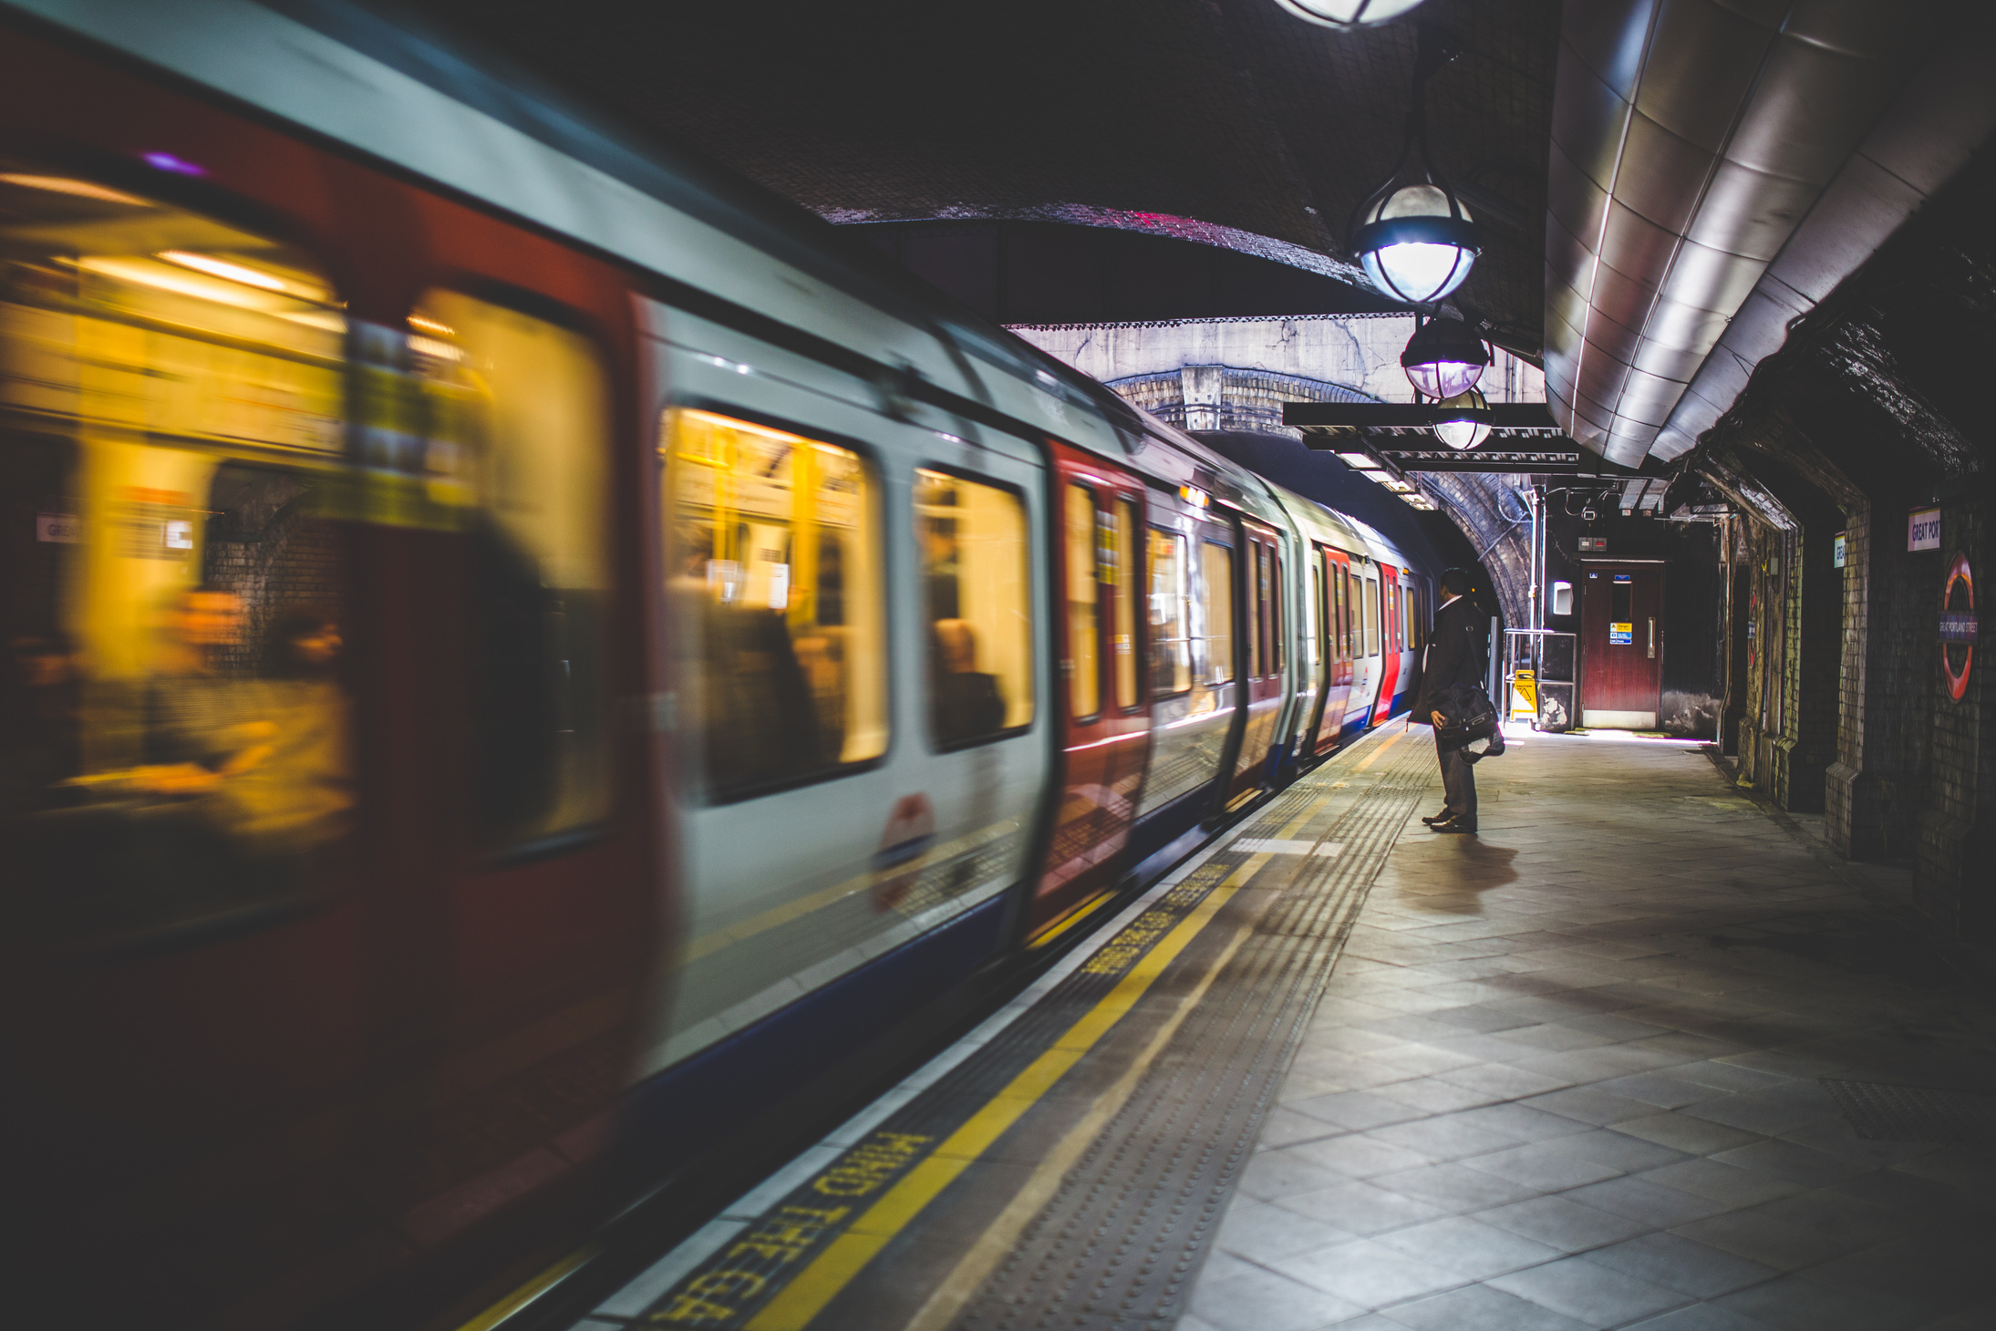
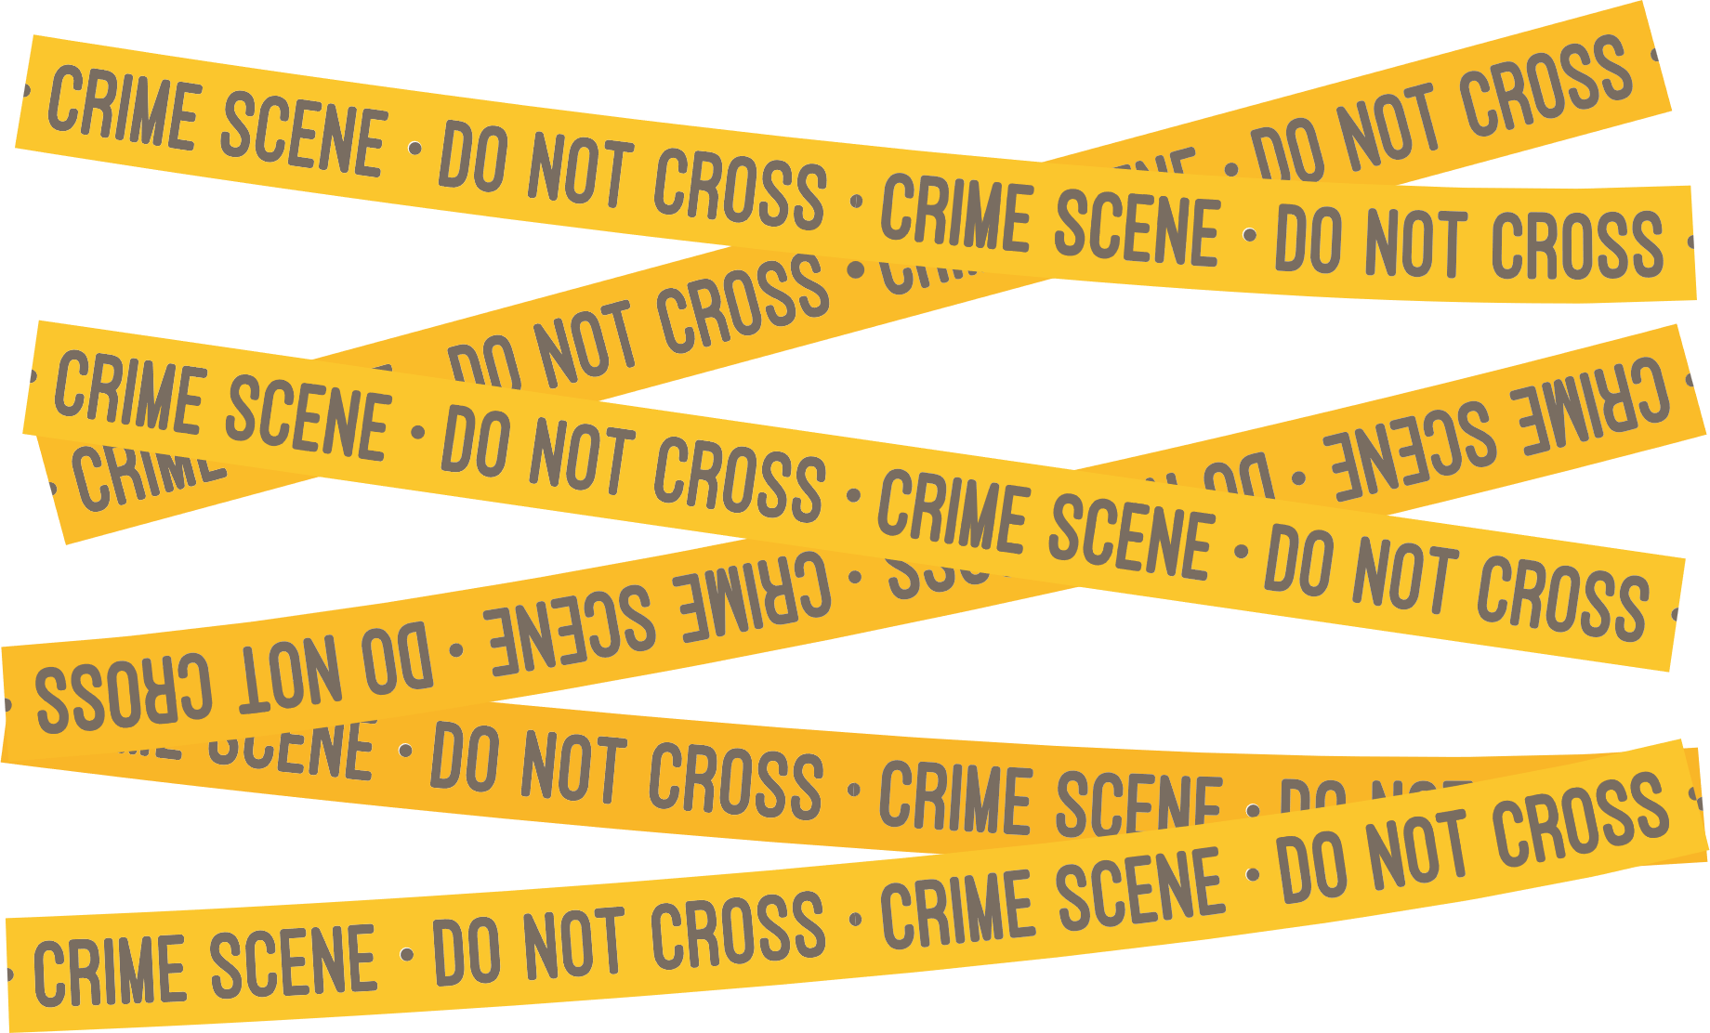
Secret of NIMBY
Analysis of Atlanta Crimes in Relation to the Location of MARTA Rail Stations (2022)
Created by
Park, Meeyoung
Marshall, Ryan
Bhimavarapu, Lakshmi
Bergman, Annalyse
Lu, Yi

Slide 2



WHAT IS
NIMBY?
An acronym for "Not In My Backyard," describes the phenomenon in which residents of a neighbourhood designate a new development (e.g. shelter, public transportation , group home) as inappropriate or unwanted for their local area.

Slide 3
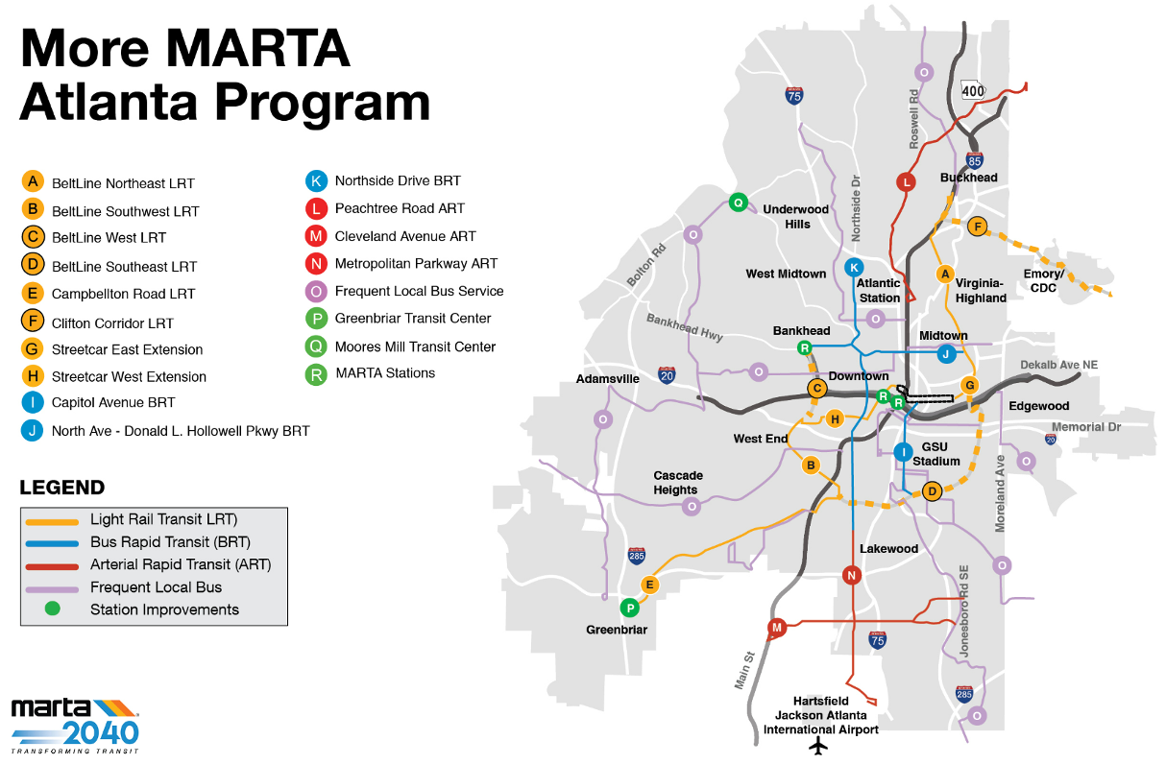
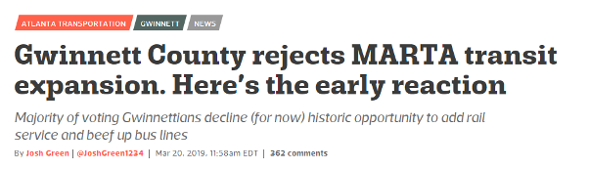
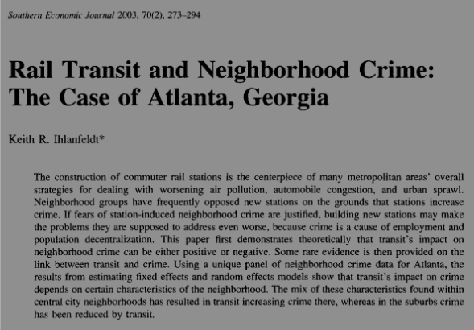

Slide 4













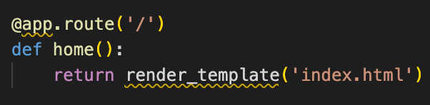
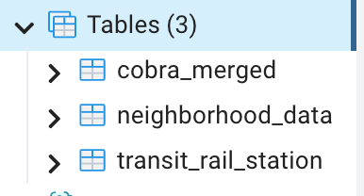

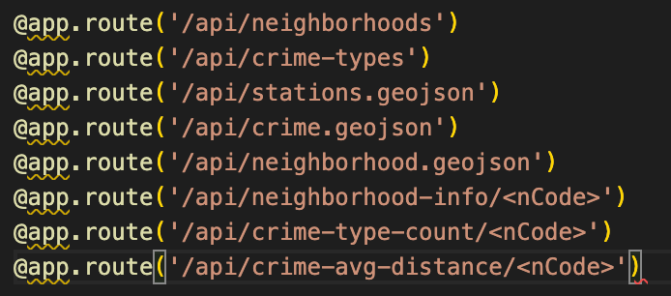

Coding Approach
Data Source
static
Atlanta Police Dept crime database (2022) (csv)
MARTA map (csv)
Atlanta neighborhood info (geojson)
Atlanta neighborhood demographics (2020) (csv)
Data:
geojson
files
Extract
Web
Geojson:
Crimes,Station
Load
Transform
API
Other Tools, Libraries, and Plug-ins:
* D3
* Bootstrap
* JQuery
* Pandas
* SQLAlchemy
* Numpy
* Datetime
* JSON
* GeoJSON
* Math
* Plotly
* Leaflet
* Leaflet Heatmap
* Leaflet Home Zoom
* Font-Awesome
* Dark Mode

Slide 5
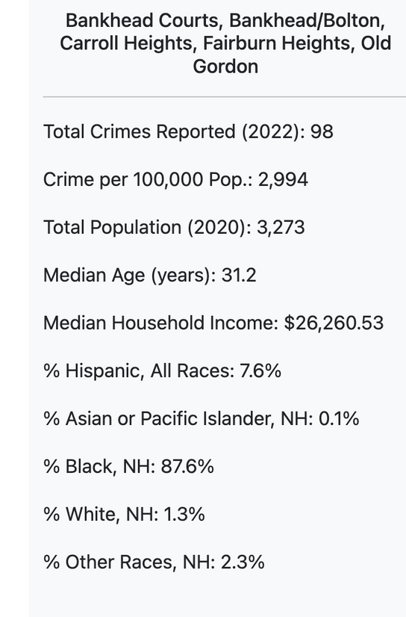
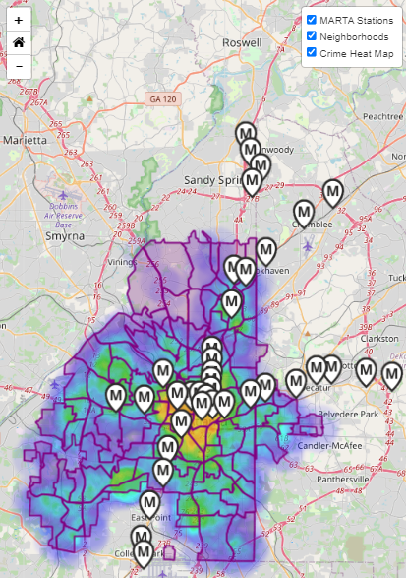
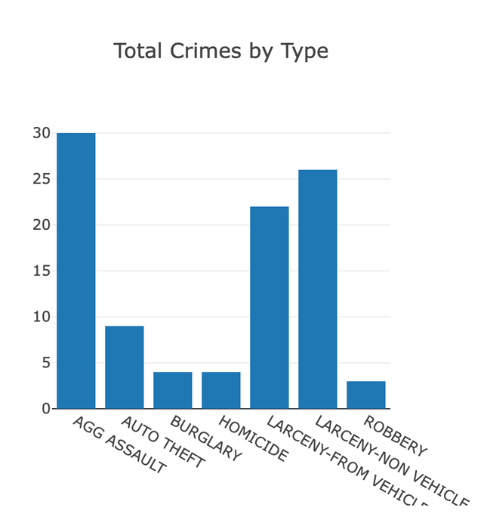
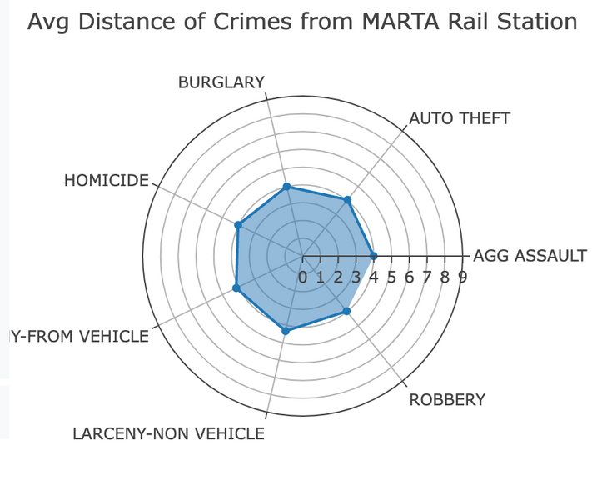
Visualizations
NEIGHBORHOOD AND CRIME INFOBOX
HEATMAP
BAR CHART
RADAR CHART

Slide 6
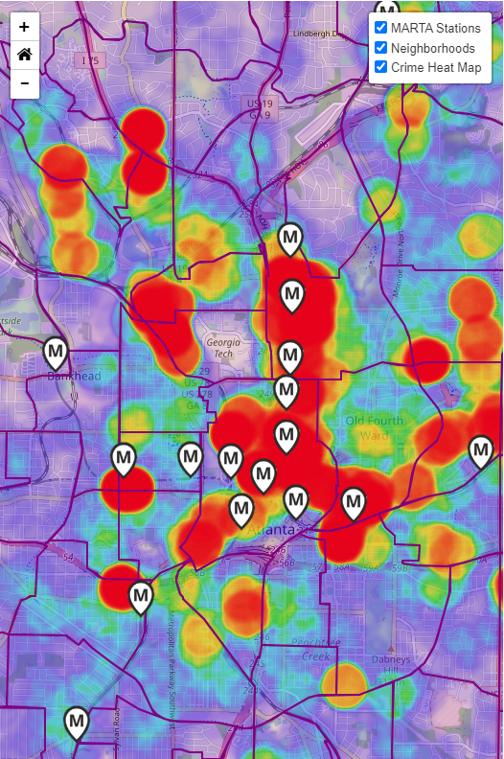
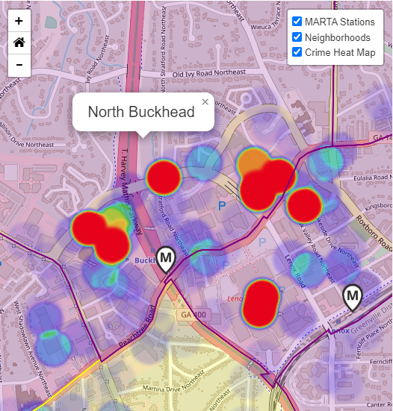
Proximity of Crimes and MARTA Rail Stations, 2022
CONCLUSION
Some correlation between the location of MARTA stations and crimes reported in Atlanta in 2022.
DISCUSSION
Weigh vs potential benefits: traffic, environmental, health, and other societal factors
Need to corroborate findings from other cities with rail stations
Other confounding factors:
Proximity to high-traffic locations (e.g. shopping malls).
Location of MARTA rail stations in urban vs rural/suburban neighborhoods
Level of security measures nearby MARTA rail stations
Notes:
Using these visualizations, we analyzed the proximity of crimes to MARTA rail stations and found that there was some level of correspondence between their locations.
Neighborhoods with or near MARTA stations tended to have crimes reported nearby. There was no significant difference overall between the type of crime reported and the distance from the station.
However, these finding warrant further investigation and insight. Firstly, when planning an expansion, the increase in crimes needs to be weighed against the potential benefits to traffic congestion, environmental impact, promotion of non-sedentary lifestyles, and other societal factors. A similar analysis would need to be conducted in other cities to corroborate findings.
Other confounding factors may affect the level of crime near MARTA stations, including proximity to high-traffic locations such as shopping malls and districts. For instance, in the map of Buckhead in the lower-left corner, you will see that reports of crime are densely centered at Lenox Mall and Phipps Plaza. MARTA rail stations are also located in urban areas vs rural or suburban areas. There may also be variable level of security measures in and around MARTA stations that affect the level of crime.

